Slide 1
Traffic System Performance Evaluation:
A Polynomial-approximation-based BPR-X Model in Phoenix
Xuesong Zhou, PhD, (xzhou74@asu.edu)
School of Sustainable Engineering and the Built Environment, Arizona State University

Slide 2
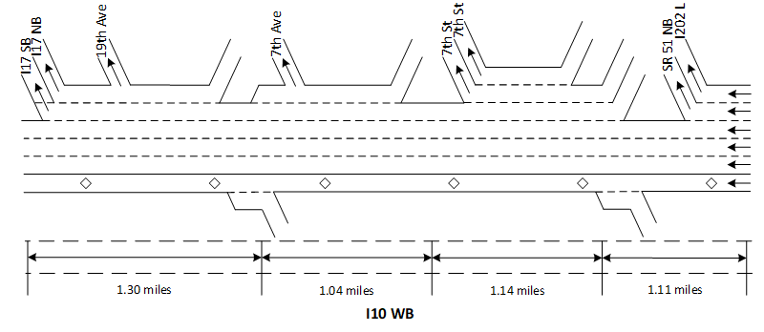
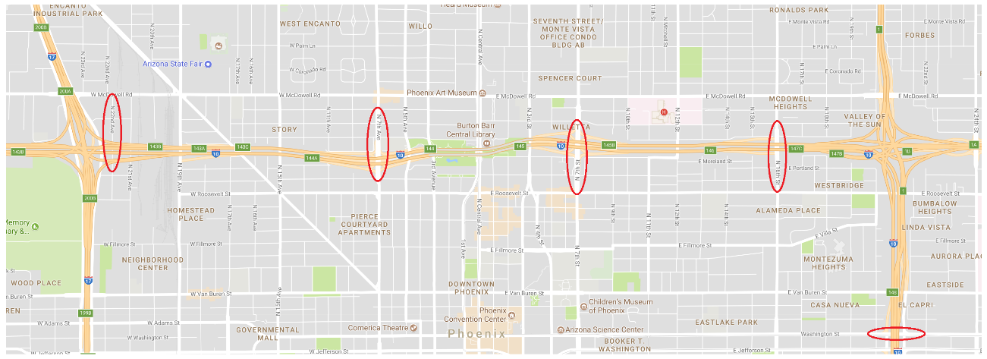
1. BPR-oriented Queue Approximation in Phoenix
Test set: The traffic data are collected from I-10 freeway corridor (Jan 5th 2016)
Detector | Description
Loop detectors | 78, 84, 137, 139
Location | I-10 freeway corridor, Westbound direction
Traffic data collected | Speed (mph) and volume (vehicle/5 minutes)
Traffic data collection period | Date: January 5th, 2016 Interval: 5 minutes (from 00:00 to 23:55)
137
78
139
84
78
139
137
78
84

Slide 3
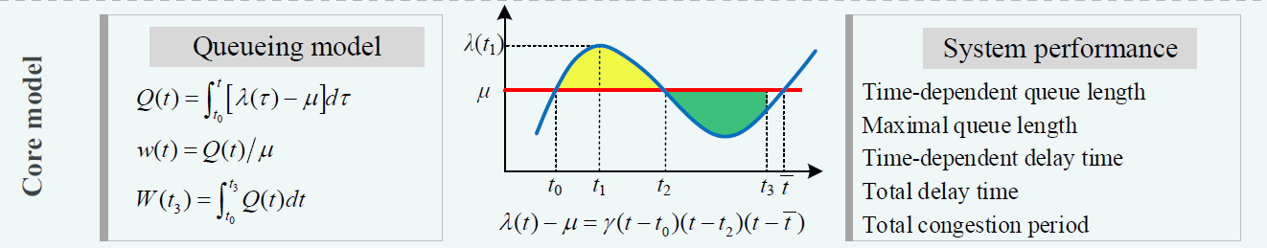
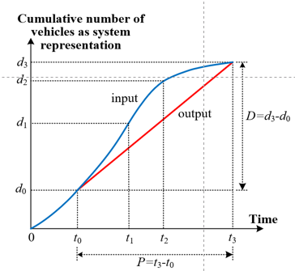
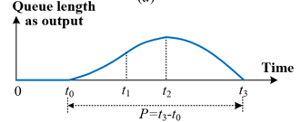
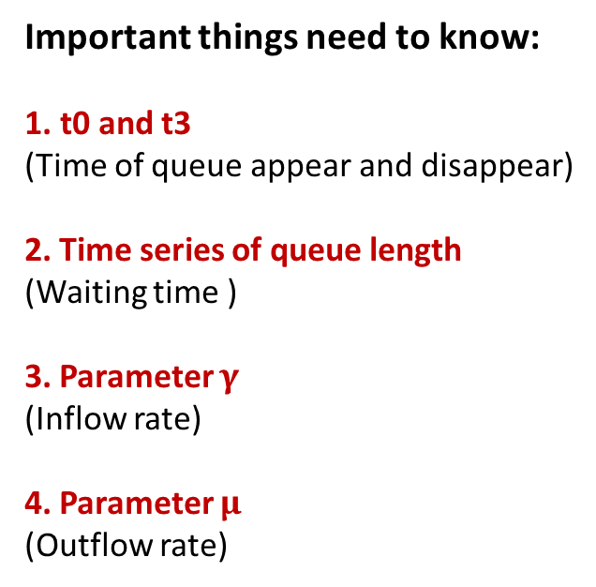
2. How to calibrate BPR-X function
Core mode: Three essential figures:
A Inflow and outflow
Important things need to know:
t0 and t3
(Time of queue appear and disappear)
2. Time series of queue length
(Waiting time )
3. Parameter $γ$
(Inflow rate)
4. Parameter $μ$
(Outflow rate)
Use cubic form polynomial function to calibrate inflow rage
B: Queue length
C: Cumulative arrival and departure

Slide 4
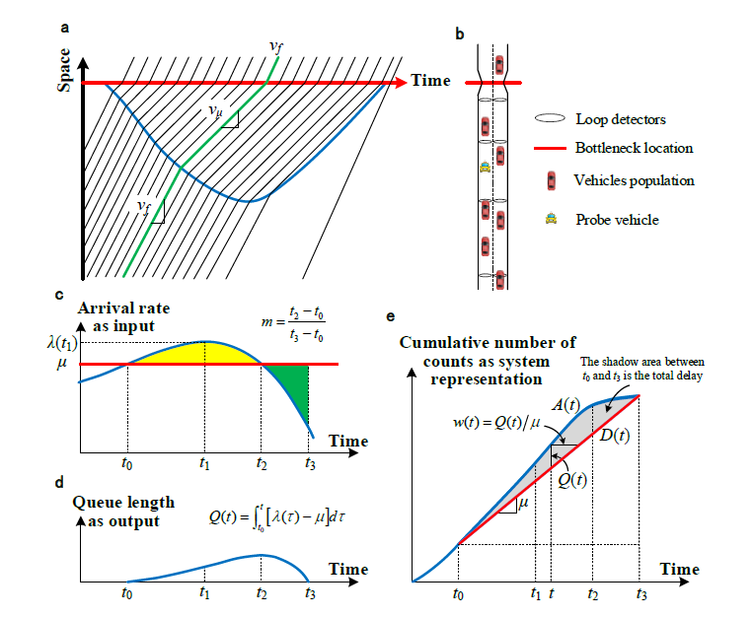
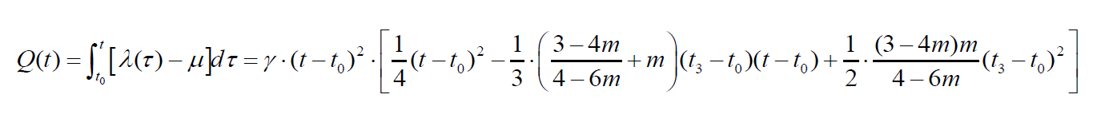

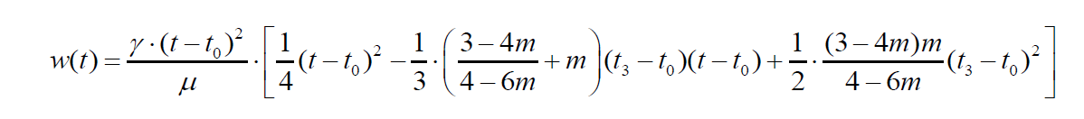


2. How to calibrate BPR-X function
Core mode: Two essential equations:
Queue length
Oversaturate factor
Waiting time
Average delay

Slide 5
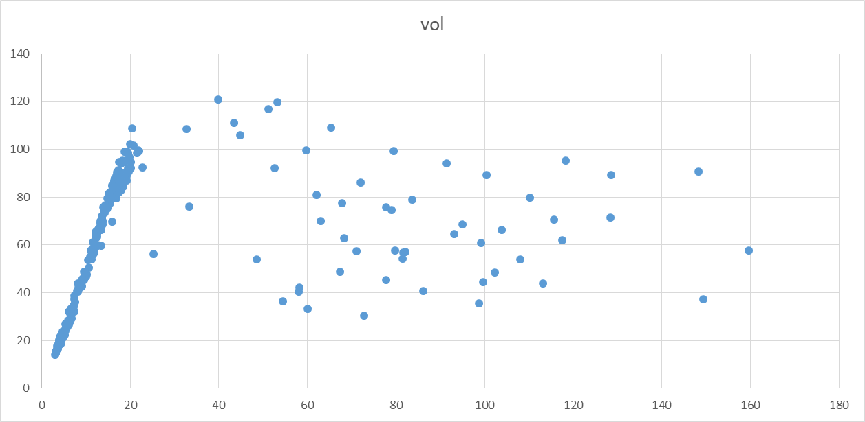
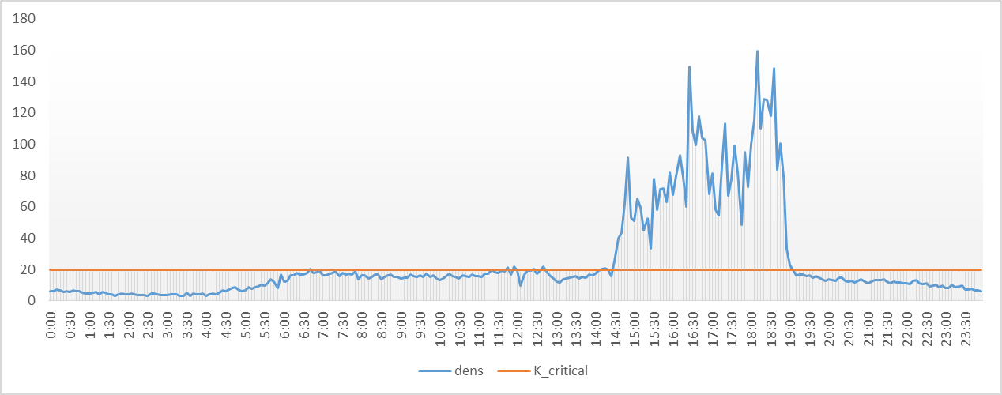
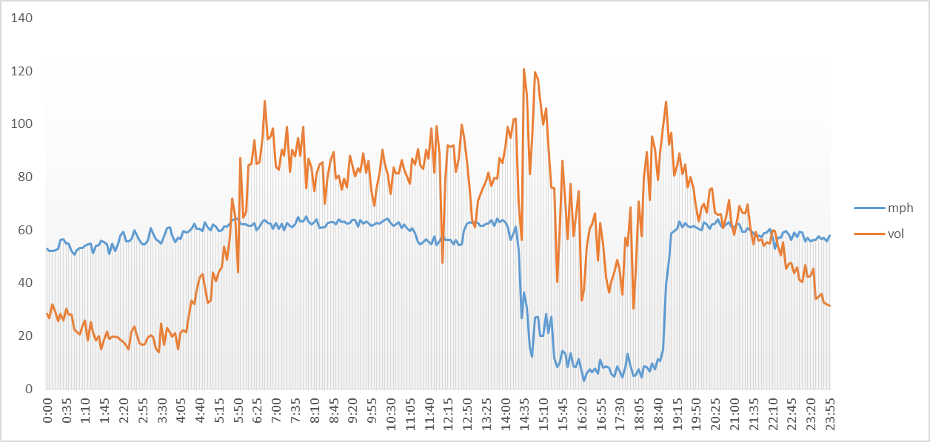
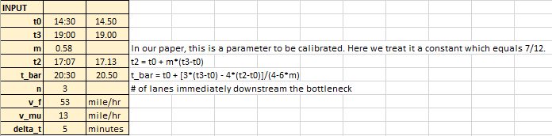
3. Calibration results：sensor 137
Q-K curve
Time series of densities and K_critical
K_critical=20
Flow per 5 min per ln
Density
t0 14:30
t3 19:00
Density
Time series of speed and flow
Flow per 5 min per ln mile per hour

Slide 6
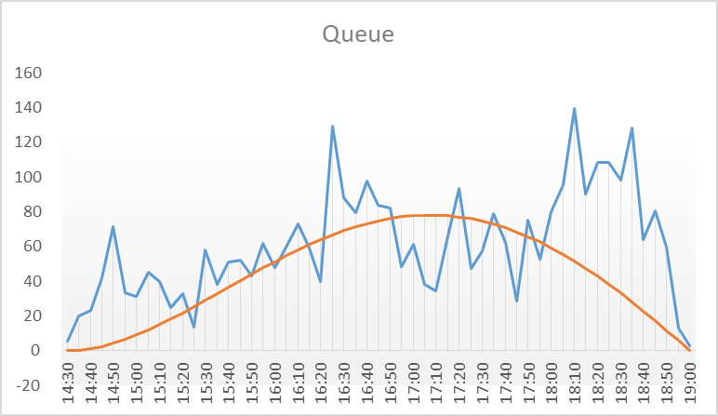
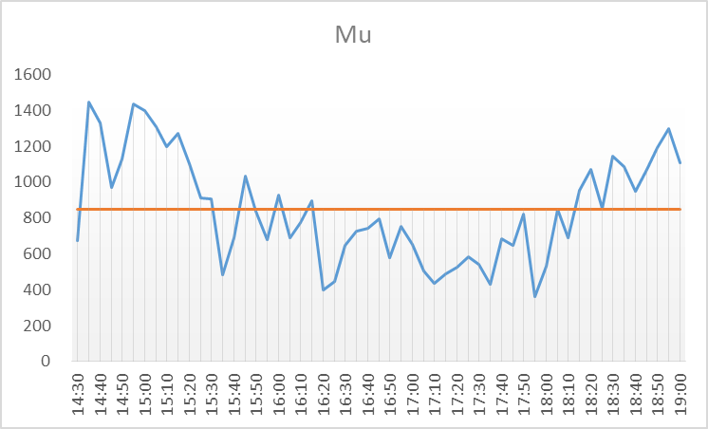

3. Calibration results：sensor 137

Slide 7
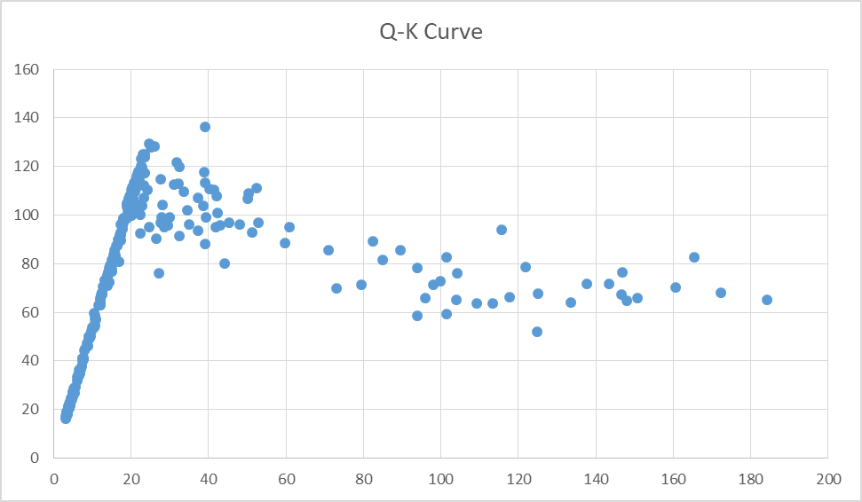
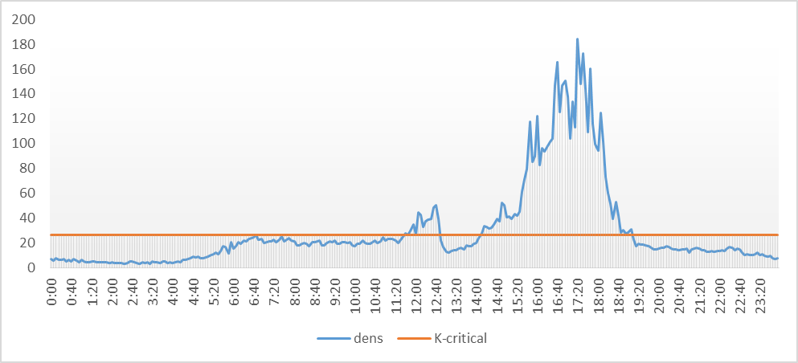
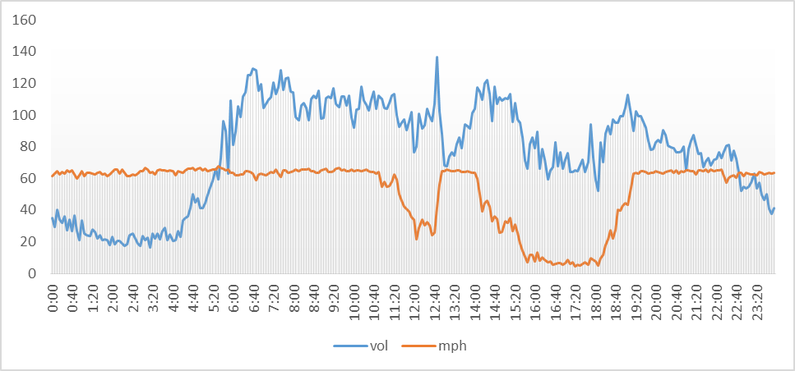
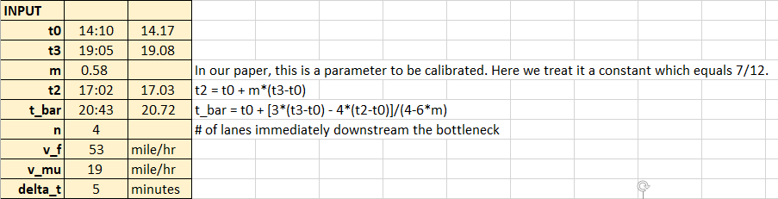
3. Calibration results：sensor 78
Time series of densities and K_critical
K_crtical=26
Flow per 5 min per ln
Density
t0 14:30
t3 19:00
Density
Time series of speed and flow
Flow per 5 min per ln mile per hour

Slide 8
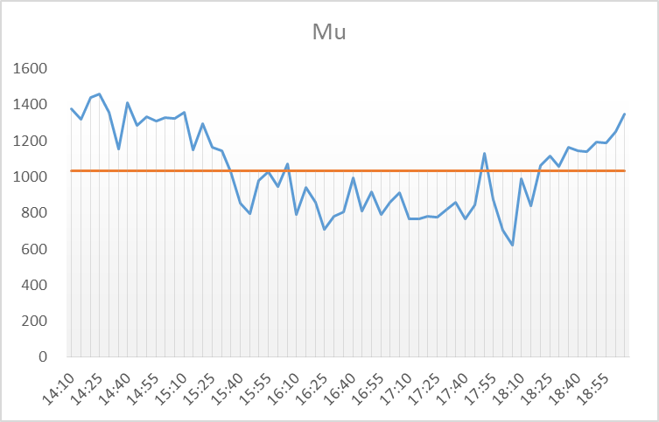
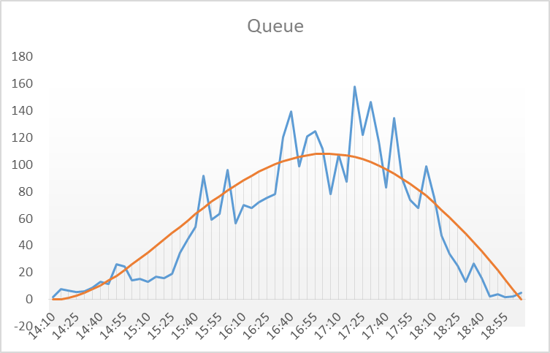

3. Calibration results：sensor 78

Slide 9
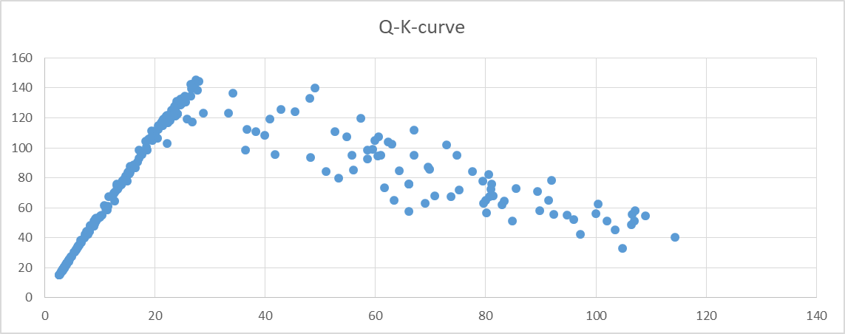
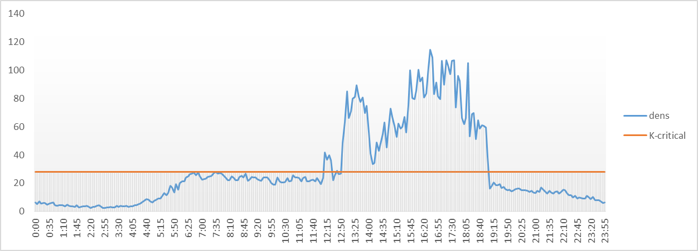
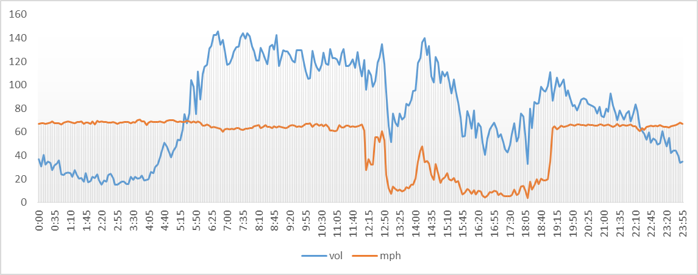
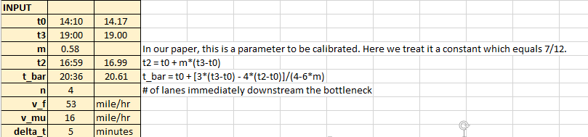
3. Calibration results：sensor 84
Time series of densities and K_critical
K_crtical=28
Flow per 5 min per ln
Density
t0 14:10
t3 19:00
Density
Time series of speed and flow
Flow per 5 min per ln mile per hour

Slide 10
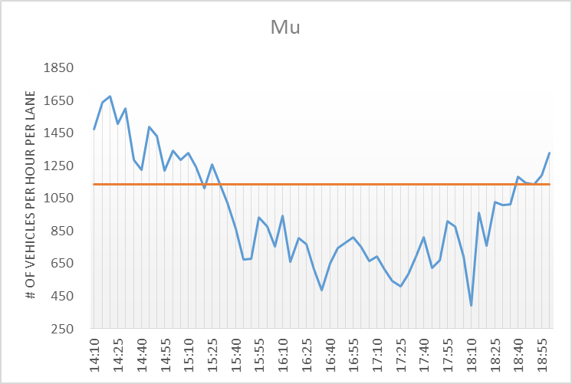
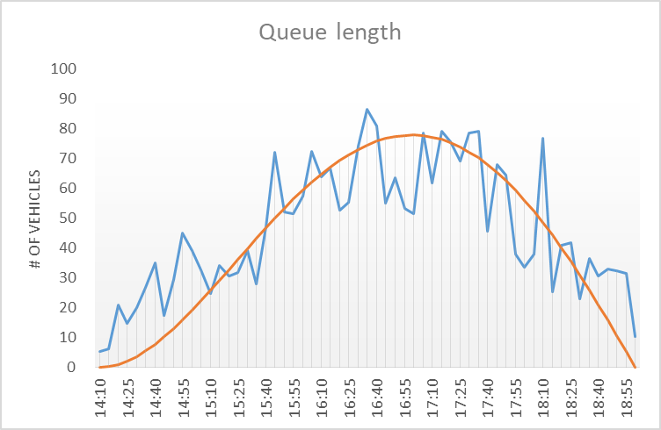

3. Calibration results：sensor 84

Slide 11
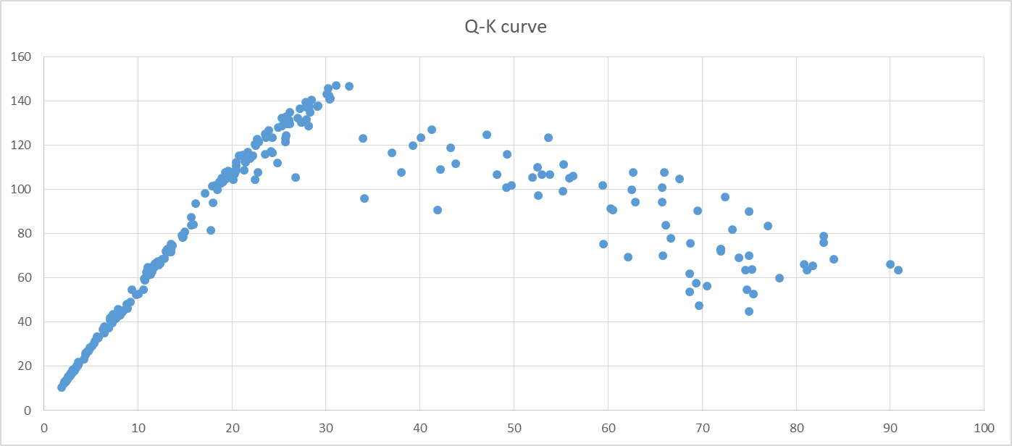
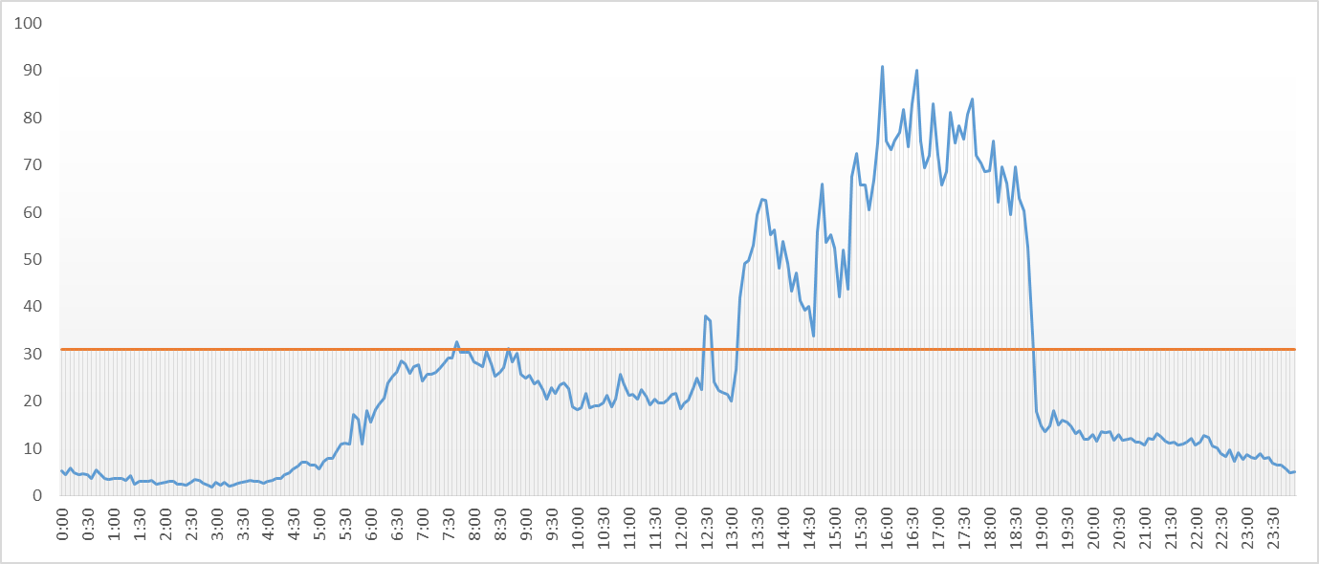
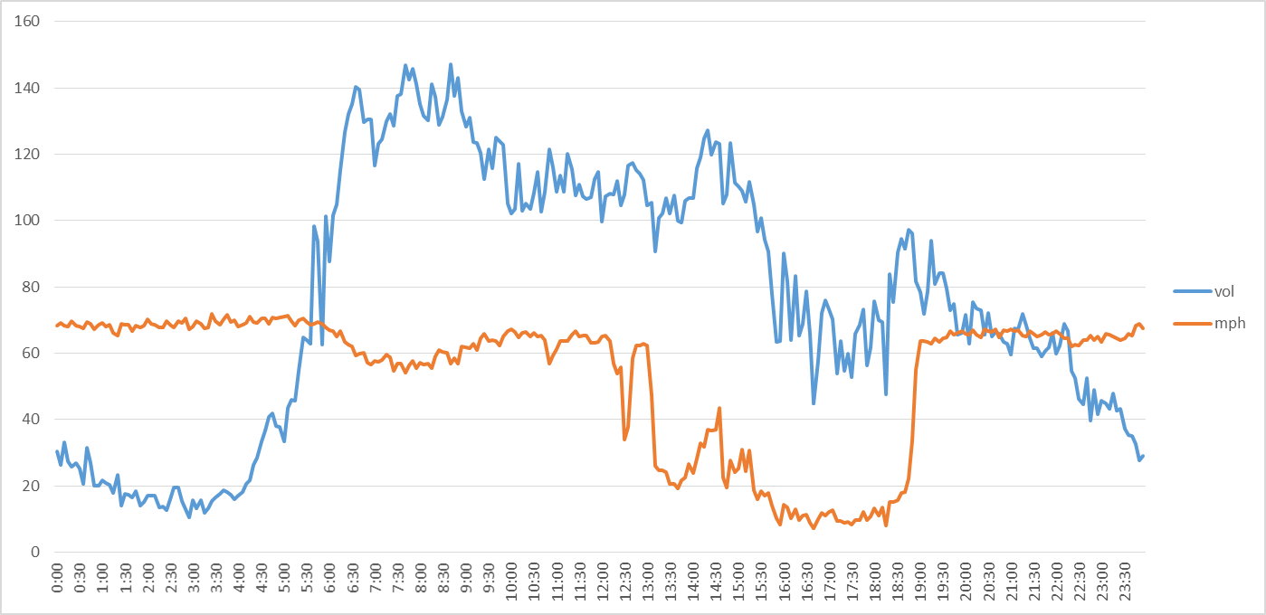
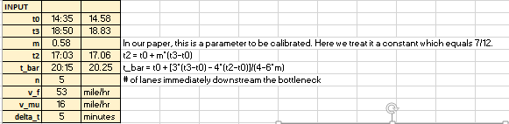
3. Calibration results：sensor 139
Time series of densities and K_critical
K_crtical=31
Flow per 5 min per ln
Density
t0 14:35
t3 18:5 0
Density
Time series of speed and flow
Flow per 5 min per ln mile per hour

Slide 12
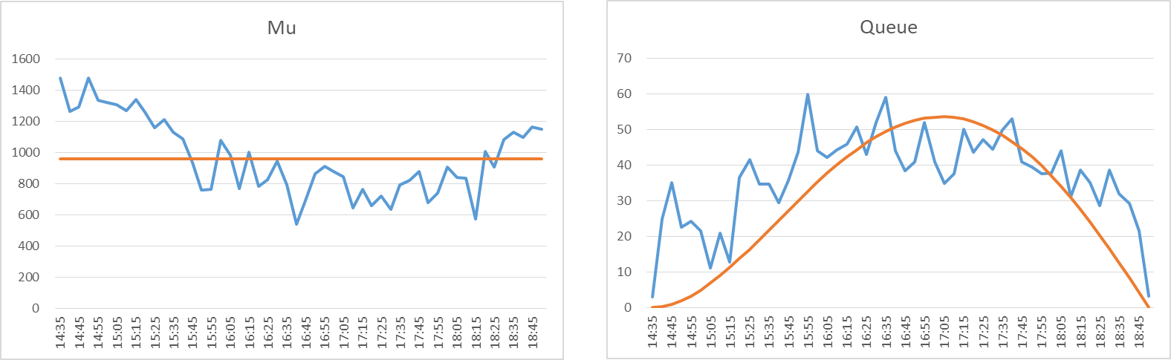

3. Calibration results：sensor 139

Slide 13
3. Calibration results：

Slide 14
4. Conclusions and Future Research
BPR travel time function and deterministic queueing model are partners without conflicts with well-posed assumptions;
The derived time-dependent travel time function can be widely used in dynamic traffic assignment, dynamic signal control, traffic system evaluation and optimization, metro demand management, etc.

Slide 15
5. Appendix
Procedure to calibrate BPR-X function
Step 1: Depict the fundamental Q-K diagram for each link
Step 2: Determine critical density (Kc) in Q-K diagram
Step 3: Determine t0 and t3 to determine t2
Step 4: Determine m, in our case study, m=7/12
Step 5: Determine mu during t0 and t3
Step 6: Determine t2 and t_bar. Determine v_mu between t0 and t3 (Average of speed)
Step 7: Use Kc and time series of density to determine physical queue length
Step 8: Use physical queue length to determine virtual queue length
Step 9: Calibrate gamma

